Slide 1
The history of periscopes

Slide 2
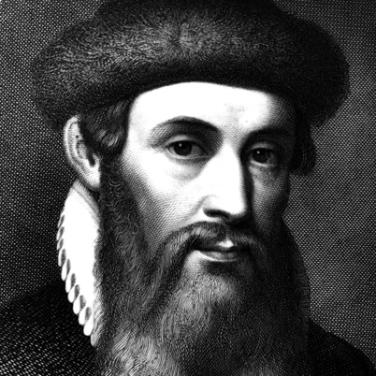
The first know periscope was invented in the 1430’s by German inventor Johannes Gutenberg. He created it so that people could see over crowds
Notes:
http://www.biography.com/people/johannes-gutenberg-9323828
© 1996–2013 A+E Television Networks, LLC. All Rights Reserved.

Slide 3
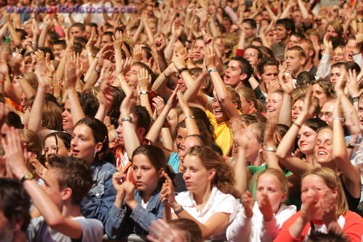
You could still use it now at sporting games, concerts and parades.
Notes:
http://www.worldofstock.com/stock-photos/crowd-scene-1/PRE1816

Slide 4
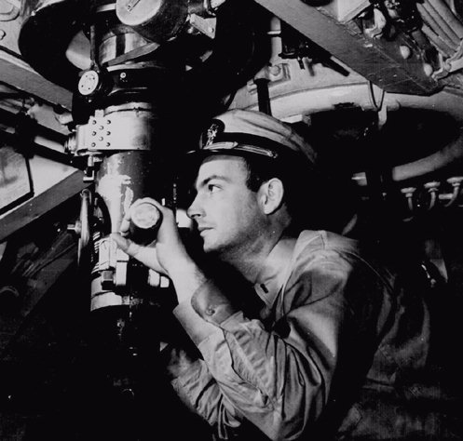
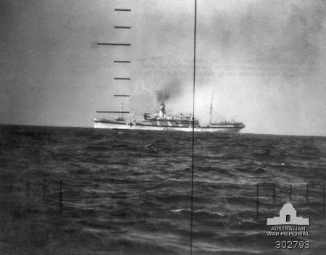
When you think of periscopes do you think of submarines? Submarines did have periscopes which they still use to see ships underwater
Notes:
Http://www.historyplace.com/unitedstates/pacificwar/ Image of inside sub
http://www.awm.gov.au/collection/302793/ periscope image

Slide 5
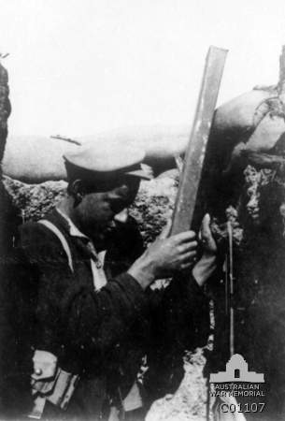
Australian troops and others used periscopes in World War 1 to see the enemy while they were in the trenches
Notes:
http://www.awm.gov.au/collection/C01107/

Slide 6
Periscopes are useful for seeing things higher than we are or blocked from our view.

